Slide 1
Patient Level Reporting
Presented By:
Lucía Lapaz, Brittany Ersery & Jim Holsinger
Envision Technology Partners, Inc.
September 2019

Slide 2
Agenda
Overview
Patient Reports
Forms / Informational Documents
SIMON Forms and Resources

Slide 3
Reports Overview
Nearly all reports are rendered as a PDF
Most PDF versions provide totals and subtotals
Some reports generate a character-delimited file for processing outside of WebIZ
CSV File: opens in Excel, comma delimiter
TXT File: opens in Notepad, pipe delimiter
Some reports generate an Excel workbook
One tab contains Report Criteria
Additional tab(s) contain(s) report output
Reports are grouped into categories
Users are granted access per category
Allows administrators to restrict access to reports containing PHI (protected health information)

Slide 4
Reports Overview (cont.)
Most reports appear in a new window
Make sure your internet browser is not blocking pop-ups!
Users are assigned a reporting level security
Unrestricted: ALL Providers & Clinics in Registry
Provider Level: Only Providers associated to the user and Clinics within those Providers
Clinic Level: Only Clinics associated to the user

Slide 5
Common Search Criteria
Provider/Clinic
Defaults to the Provider/Clinic selected on Home screen
Can be changed depending on user security
Date Ranges
Vaccination Date Range
Patient DOB Date Range

Slide 6
Patient Reports

Slide 7
Immunization Administration Chart
More detailed version of a patient’s immunization record
Report output includes:
Clinic Name/Address
Patient ID
Patient Name
Gender
Patient Date of Birth
Mother’s Maiden Name
Patient Address
Patient Contact Information
Vaccine Information
Date Given
Administered By
Body Site
Route
Manufacturer
Lot Number
VFC Code

Slide 8
IZ History/Risk/Recommendations
Display results of the Recommender, including:
Patient immunization history
Patient precautions / contraindications
Recommended vaccinations for today
Future recommended vaccinations (assuming all recommended vaccinations for today are administered)
Equivalent to clicking Recommend button on Immunizations Home screen

Slide 9
Patient Administrative Record
More detailed version of the Immunization Record
Report output includes:
Vaccine
Dose Number
Date Given
Age at Vaccination
Administering Clinic
Administered By
Body Site
Route
Manufacturer
Lot Number
Dosage
VIS Date
Adverse Reactions specified
Known Patient Precautions / Contraindications

Slide 10
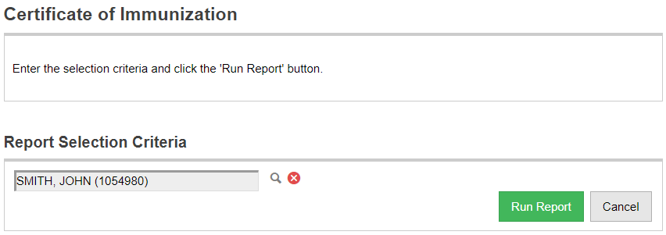
Certificate of Immunization
1
2
3
4
Use the lookup tool to search for a patient.
Clear the currently selected patient.
Generate the patient’s Immunization Record.
Return to the Reports home screen.

Slide 11
Personal Immunization Record
For personal immunization record keeping only.
Not an official Immunization certification to be used for Childcare or School entry.

Slide 12
Patient Reports
Hands-On Exercise

Slide 13
Forms / Informational Documents

Slide 14
ACIP Immunization Schedules
ACIP Child and Adolescent Immunization Schedule
ACIP Adult Immunization Schedule

Slide 15
Clinic Contact Listing
Generates a list of all VFC/VTrckS contacts for the selected Provider/Clinic(s), including:
Name
Telephone
Fax
Email
Available filters:
Clinic Status
VTrckS Status
Available as PDF, Excel, or extract

Slide 16
Product Listing
Generates a directory of all vaccine products in the registry
Available filters:
Manufacturer
Vaccine
Registry Status (Active or Inactive)
VTrckS Status (On Contract or Not on Contract)
Intent (Adult or Pediatric)
Direct Ship (Frozen)
Available as PDF or extract

Slide 17
Vaccine Information Statements (VIS)
View (and print) PDF versions of VIS
Option to display ALL vaccines or CHILD vaccines only

Slide 18
Forms / Informational Documents
Hands-On Exercise

Slide 19
SIMON Forms and Resources
Notes:
CNMI only at this time

Slide 20
Editable Reports Category
Users with appropriate security can add, edit, or delete reports as needed
Accepted report formats include:
Downloadable file (such as PDF or .DOCX)
URL (link to external website)
Notes:
CNMI only at this time

Slide 21
SIMON Forms and Resources
Hands-On Exercise

